Slide 1
NORMANS RULES FOR INTERFACE DESIGN
Visibility
Feedback
Constraints
Mapping
Consistency
Affordance

Slide 2
Normans Rules for Interface Design
Visibility
The more visible functions are, the more likely users will be able to know what to do next.
In contrast, when functions are "out of sight", it makes them more difficult to find and know how to use.
Feedback
Allowing the person to continue with the activity.
Types such as tactile, verbal and combinations of these.

Slide 3
NORMANS RULES FOR INTERFACE DESIGN
Constraints
Restricting the kind of user interaction that can take place at a given moment.
Mapping
Relationship between controls and their effects in the world. up and down arrows used to represent the up and down movement of the cursor, respectively, on a computer keyboard.

Slide 4
NORMANS RULES FOR INTERFACE DESIGN
Consistency
Interfaces to have similar operations and use similar elements for achieving similar tasks.
Using the same input action to highlight any graphical object at the interface, such as always clicking the left mouse button. Inconsistent interfaces, on the other hand, allow exceptions to a rule.
Affordance
At a very simple level, to afford means " to give a clue" (Norman, 1988).
When the affordances of a physical object are perceptually obvious; it is easy to know how to interact with it.

Slide 5
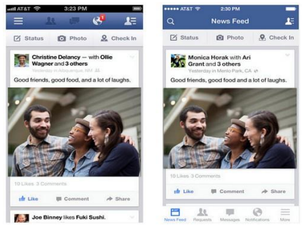
WRAP UP…..
VISIBILITY
Hamburger side-bar menus and tab-bar menus in mobile applications

Slide 6
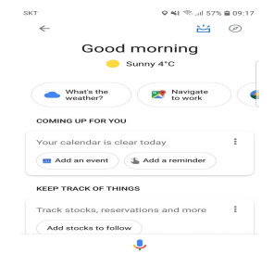
WRAP UP…
FEEDBACK
Many forms of feedback exist in interaction design, including visual, tactile, audio, and more.

Slide 7
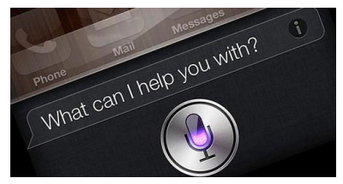
WRAP UP…
CONSTRAINTS
Constraints is about limiting the range of interaction possibilities for the user to simplify the interface and guide the user to the appropriate next action.

Slide 8

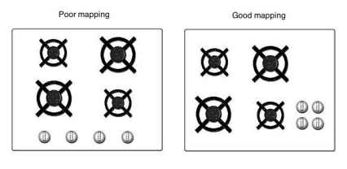
WRAP UP…
MAPPING
This slider also has a strong
mapping, since it’s clear moving it to the right will increase it’s value versus moving it to the left will decrease it.

Slide 9
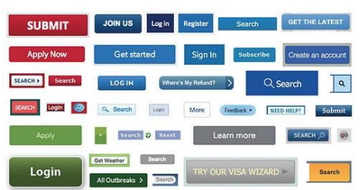
WRAP UP…
CONSISTENCY
This is a simple example of poor consistency when you are using so many different styles for actions within your interface.

Slide 10
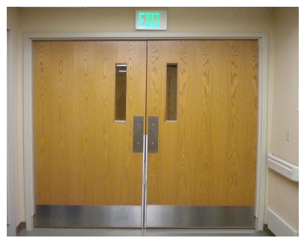
WRAP UP…
AFFORDANCE
When you do this, you are giving the door a strong affordance to indicate it should be pushed instead of pulled.

Slide 11
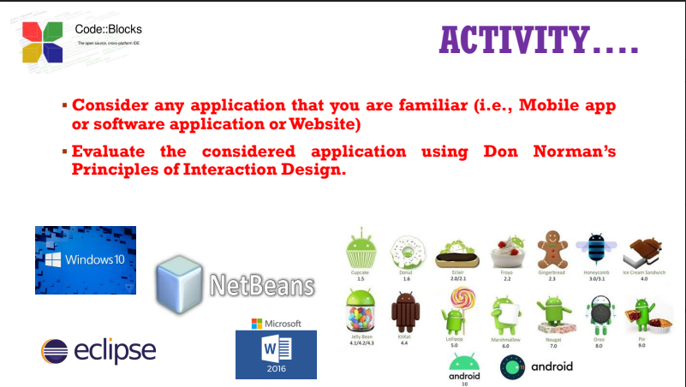

Slide 12
PRINCIPLES TO SUPPORT USABILITY
Learnability
The ease with which new users can begin effective interaction and achieve
maximal performance
Flexibility
The multiplicity of ways the user and system exchange information
Robustness
The level of support provided the user in determining successful achievement
and assessment of goal-directed behavior

Slide 13
PRINCIPLES OF LEARNABILITY
Predictability
Determining effect of future actions based on past interaction history
Operation visibility
Synthesizability
Assessing the effect of past actions
Familiarity
How prior knowledge applies to new system
Guessability; affordance

Slide 14
Generalizability
Extending specific interaction knowledge to new situations
Consistency
Likeness in input/output behaviour arising from similar situations or task objectives

Slide 15
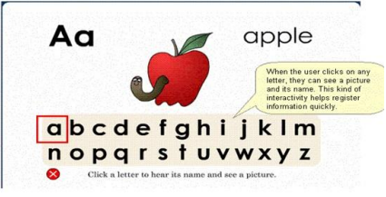
LEARNABILITY

Slide 16
PRINCIPLES OF FLEXIBILITY
Dialogue initiative
Freedom from system imposed constraints on input dialogue
Multithreading
Ability of system to support user interaction for more than one task at A time
Task migratability
Passing responsibility for task execution between user and system

Slide 17

FLEXIBILITY

Slide 18
PRINCIPLES OF ROBUSTNESS
Observability
Ability of user to evaluate the internal state of the system from its perceivable representation
Recoverability
Ability of user to take corrective action once an error has been recognized
Reachability; forward/backward recovery; commensurate effort
Responsiveness
How the user perceives the rate of communication with the system Stability
Task conformance
Degree to which system services support all of the user's tasks

Slide 19
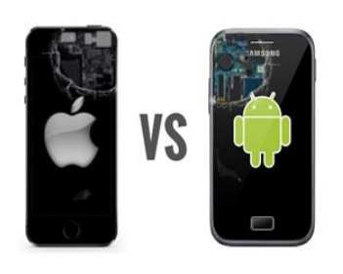
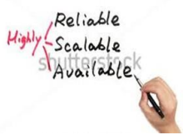
ROBUSTNESS
The quality or condition of
being strong and in good
condition.

Slide 20
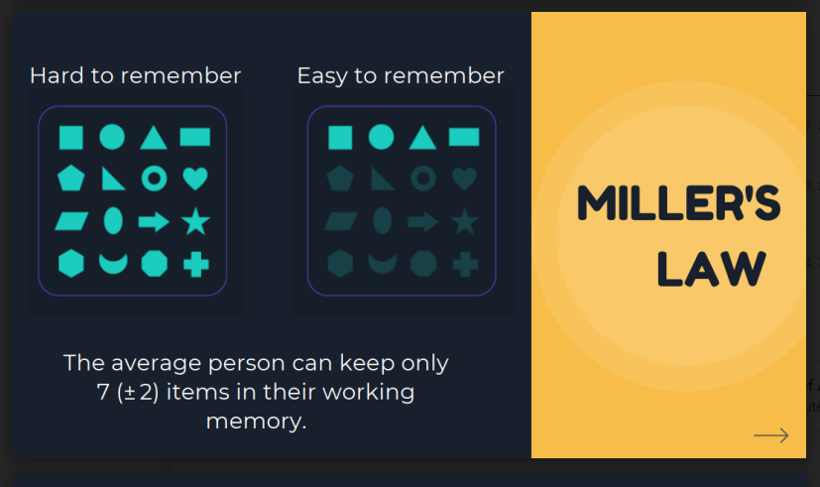

Slide 21


Slide 22
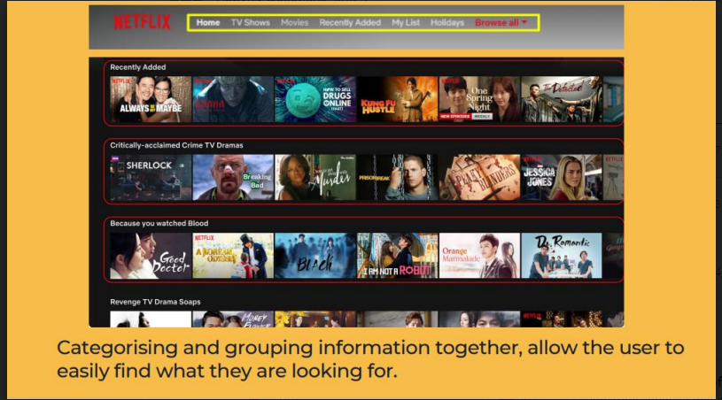

Slide 23
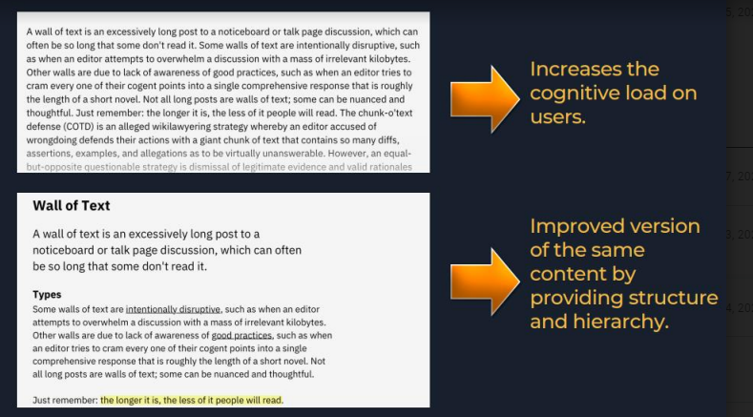

Slide 24
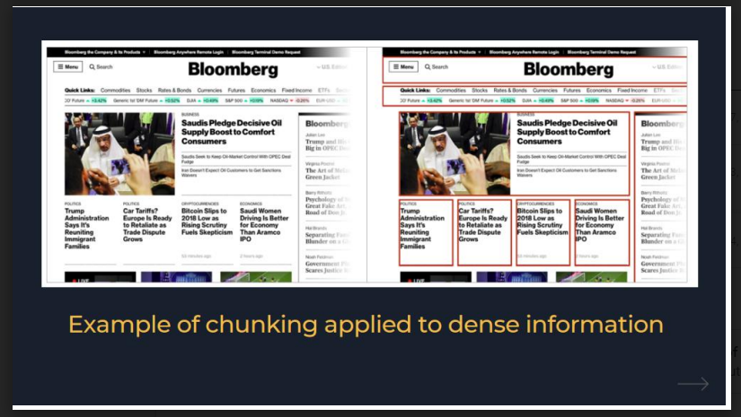

Slide 25
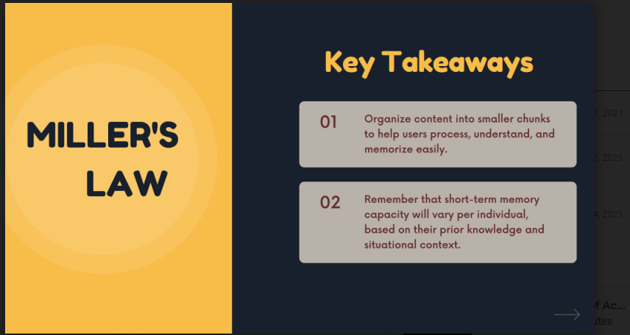

Slide 26
Donald Norman’s model
Seven stages
  user establishes the goal
  formulates intention
  specifies actions at interface
  executes action
  perceives system state
  interprets system state
  evaluates system state with respect to goal
Norman’s model concentrates on user’s view of the interface

Slide 27
execution/evaluation loop
    user establishes the goal
    formulates intention
    specifies actions at interface
    executes action
    perceives system state
    interprets system state
    evaluates system state with respect to goal
goal
execution
evaluation
system

Slide 28
execution/evaluation loop
    user establishes the goal
    formulates intention
    specifies actions at interface
    executes action
    perceives system state
    interprets system state
    evaluates system state with respect to goal
goal
execution
evaluation
system

Slide 29
execution/evaluation loop
goal
    user establishes the goal
    formulates intention
    specifies actions at interface
    executes action
    perceives system state
    interprets system state
    evaluates system state with respect to goal
execution
evaluation
system

Slide 30
execution/evaluation loop
goal
    user establishes the goal
    formulates intention
    specifies actions at interface
    executes action
    perceives system state
    interprets system state
    evaluates system state with respect to goal
execution
evaluation
system

